Slide 1
Developing services with Azure Functions 2.0
Kamil Mrzygłód, Jakub Gutkowski | AzureDay 2019, Poland

Slide 2
Agenda
Introduction
V1 and V2 differences
Developing Azure Functions
Deploying
Debugging
Custom bindings and triggers
Azure Event Grid and Azure Logic Apps integration

Slide 3
Introduction
Who are we?

Slide 4
Who are we?
Kamil Mrzygłód
Jakub Gutkowski
Senior Software Developer @ Demant Technology Centre
Trainer, consultant and book author
Microsoft Azure MVP
Husband, Father, trainer, consultant, blogger
Microsoft MVP

Slide 5
V1 and V2 differences
What has changed recently?

Slide 6
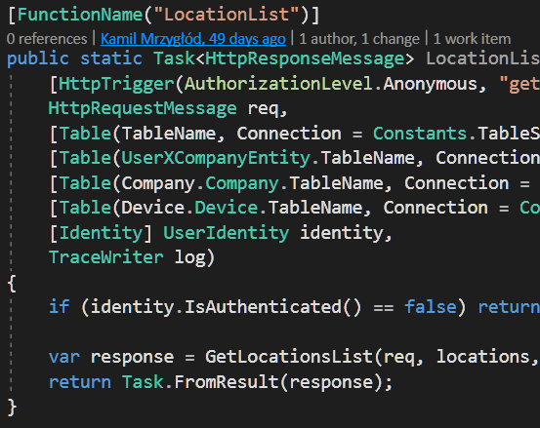
Azure Functions V1
.NET Framework
Based on Azure WebJobs
Quickly become really popular
FaaS offer for Azure
Dependencies hell
Sloppy [HttpTrigger]
Extensible
C#, F#, NodeJS support(other languages like Python or Typescript in the experimental phase)

Slide 7
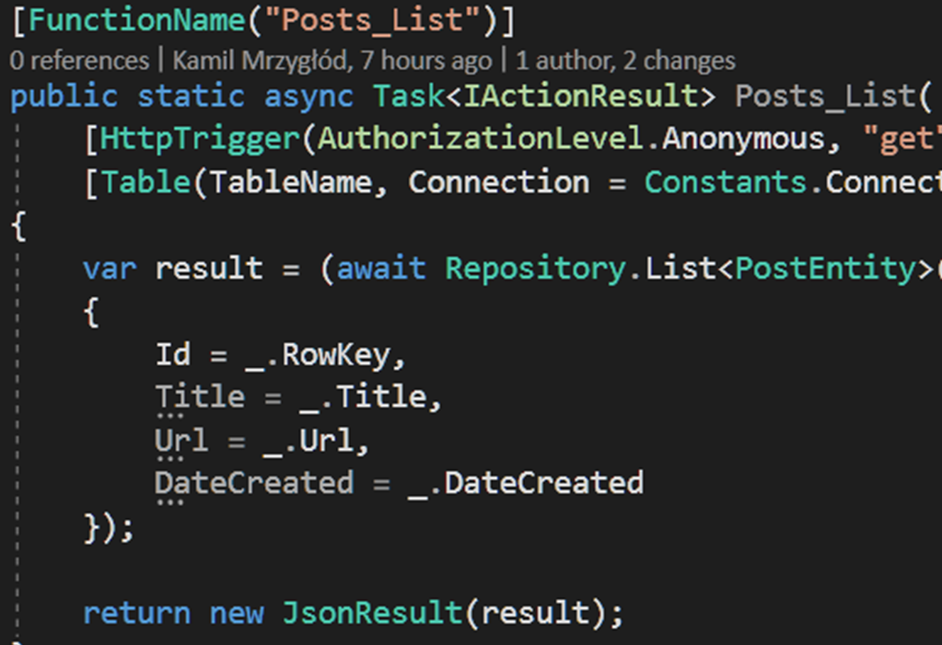
Azure Functions V2
.NET Core
Based on Azure Functions V1
Extensions model changed
Only one language per Function App
Java support
Dropped experimental support for languages like PHP, Powershell* or Bash
* It’s coming…

Slide 8
V1 and V2 comparison
Azure Functions V1
Azure Functions V2
.NET Framework
Multiple languages supported in a single Function App
Many core extensions(mainly Azure Storage) already packaged inside the runtime
Lacking performance
Obscure extensions model
Cannot run on Linux/macOS
.NET Core
Dropped support for multiple languages
Need to install each required extension
Improved performance
Improved extensions API
Runs on Windows/Linux/macOS

Slide 9
Developing Azure Functions
Toolset, CLI, basic concepts

Slide 10
Toolset
Visual Studio or Visual Studio Code
Azure Functions CLI
Storage Emulator
Microsoft Azure Storage Explorer

Slide 11
CLI
Win: npm i -g azure-functions-core-tools --unsafe-perm true
Linux: sudo apt-get install azure-functions-core-tools
macOS: brew install azure-functions-core-tools

Slide 12
Getting started
To initialize a new Functions project, run func init and select the runtime you are interested in

Slide 13
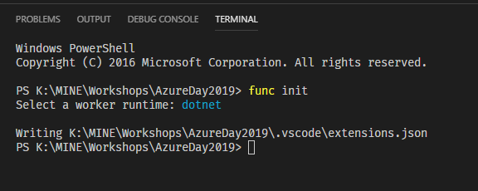

Slide 14
Creating a function
To create a function, run the func function new command and select the trigger you are interested in

Slide 15
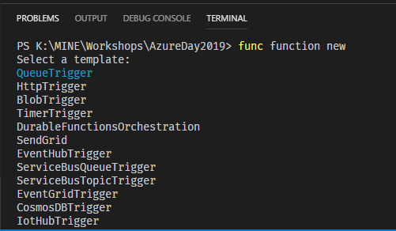

Slide 16
Starting the host
To start the host, run the func host start command

Slide 17
Triggers and bindings
Trigger
Binding
A function can have only one trigger
Makes your function execute
Function App can have multiple different triggers
Most of the native triggers require Azure Storage to work correctly
Integrates your function with external dependencies(like storage, bus or APIs)
A function can have multiple different(or the same) bindings
Evaluated before function execution(though runtime binding is also possible)

Slide 18
Exercises
Initialize a new Function App in NodeJS and add a new HttpTrigger to it
Initialize a new Function App and:
Add a function triggered by Blob
Add a function triggered by Timer
Set a timer to trigger a function each 1 minute
Add a function triggered by HTTP and ensure, that it can be called only via POST calls

Slide 19
Deploying
Deploy your functions to Azure

Slide 20
Creating a Function App
To get started, we will need a Function App in our resource group

Slide 21
Credentials
user(1-8)@kamilthecloudtheory.onmicrosoft.com
AaBbCc123

Slide 22
Deploying to Azure
To deploy your Function App to Azure, run the func azure functionapp publish command

Slide 23
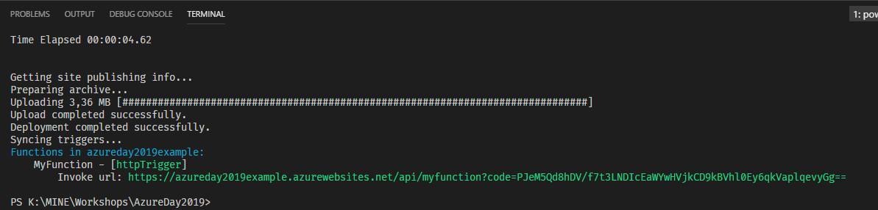

Slide 24
Exercises
Add a new function to your Function App and deploy it once again
Create new Function App with an HTTP trigger and deploy it using –nozip switch, compare both applications
Deploy a Function App(.NET) without building it. Make a local change and retry. Is your change available in Azure?

Slide 25
Debugging
Locally & Remotely

Slide 26
Debugging locally
To debug locally, put a breakpoint where you want the execution to stop and hit F5 button

Slide 27
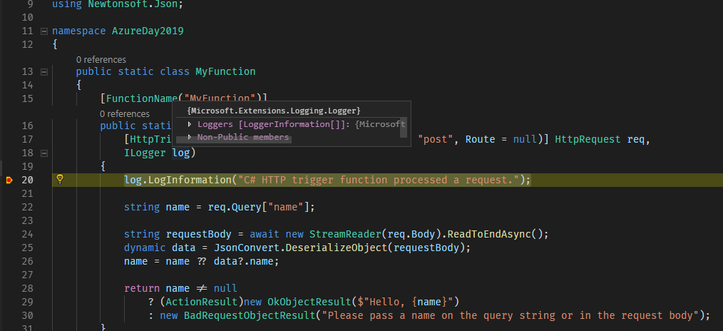

Slide 28
Things to note
The debugging experience in VS and VS Code are very similar
You cannot use func host start to debug your functions
A running host is needed to be able to debug functions

Slide 29
Debugging remotely
To debug remotely, publish your Function App and use Cloud Explorer to attach a debugger

Slide 30
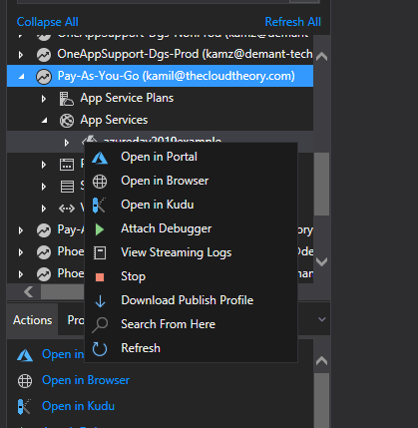

Slide 31
Things to note
Remote debugging is only available in VS
Debugging remotely on production may not be the best way to find bugs ☺

Slide 32
Custom bindings and triggers
Writing your own extensions

Slide 33
Extension API
Bindings
Triggers
IWebJobsStartup
IExtensionConfigProvider
Attribute
IBindingProvider
IBinding
IValueProvider
IWebJobsStartup
IExtensionConfigProvider
Attribute
ITriggerBindingProvider
ITriggerBinding
IValueProvider
IListener
ITriggerData

Slide 34
Binding idea
Automatic retrieving parameters from the query string

Slide 35
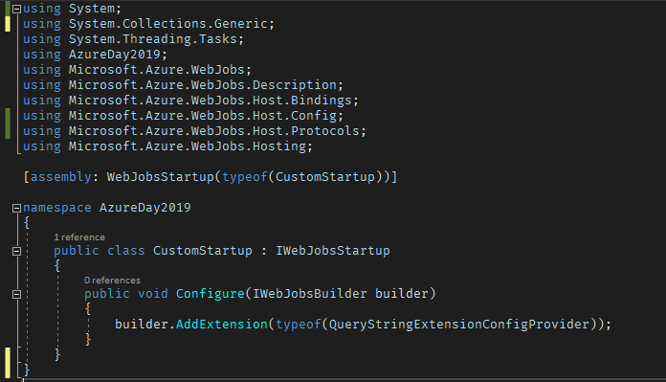
Getting started with IWebJobsStartup

Slide 36
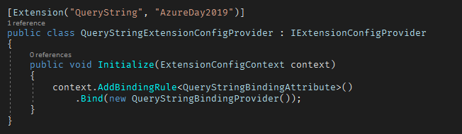
Getting started with IExtensionConfigProvider

Slide 37

Getting started with an attribute

Slide 38
Exercises
Add a new function triggered by HTTP – change its logic to use the custom binding
Change the logic of the binding, so it returns only the first N parameters

Slide 39
Trigger idea
Triggering a function with tweets

Slide 40
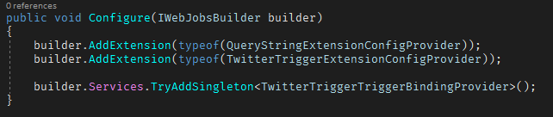
Getting started with IWebJobsStartup

Slide 41
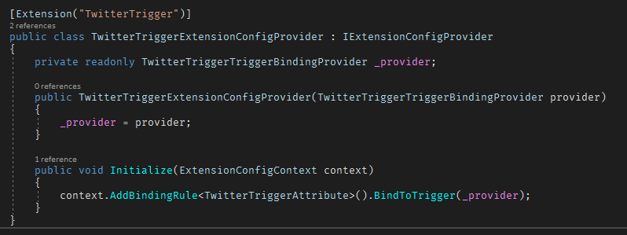
Getting started with IExtensionConfigProvider

Slide 42
Exercises
Implement a function triggered by the TwitterTrigger
Change the logic of the trigger, so a function is triggered by a text passed via parameter
Implement a simple BlobTrigger

Slide 43
Testing functions locally
Writing your own tests

Slide 44
Unit Testing
So what exactly our function should return?

Slide 45
Unit Testing
Do/Helps with
Does not mean
Tests only single, small possible unit of code – method, action, function
Tests only public methods/actions/functions
Verifying if what we implemented behave as planned
„Protecting” against breaking changes
Guiding „implementations”
Keeping code „simple”
Bug free code
That business process had been properly implemented
That code should not be tested differently

Slide 46
Toolset
Visual Studio or Visual Studio Code
xUnit

Slide 47
xUnit
Unit Testing framework developed by MS
Available on nuget
Supported by variety of tools
Simple in use
Favors code clarity over attributes nightmare
”Basically” have only one attribute

Slide 48
xUnit - Demo
Simple Unit Test in simplest possible form
Sample Unit Test of Function

Slide 49
Unit Testing – Exercises (1)
Create two projects
xUnit (add reference to Function)
Function
Create new default HttpTrigger Function
Test if function work properly with name as:
Query string
Body – use mem stream and stream writer

Slide 50
Unit Testing – Exercises/Discussion (2)
Unit test created Custom Binding
Unit test created Custom Trigger

Slide 51
Things to note
Unit Testing function is almost as simple as unit testing normal code
Functions are testable by default
Testing is not always “simple”

Slide 52
Azure Event Grid
Serverless Events

Slide 53
Event Grid
Provides a way to connect multiple Azure services in event driven way
Made for performance and scalability
Allows filtering of events
A “missing” connecter between thing that had happened, and listener how is interested in what had happened
Works perfectly in “serverless” idea as reactive solution instead of proactive (pulling)
100 000 operation* per moth are free

Slide 54
Toolset
Visual Studio or Visual Studio Code
Ngrok
Azure CLI
Azure Portal
A little patience TM

Slide 55
Event Grid vs Event Hubs vs Service Bus
React to status change
Serverless
At least one delivery
Dynamically scalable
Event base
Distributed data streaming
Low latency
Millions of events per second
At least one delivery
Event base
Order processing
Financial transactions
Reliable delivery that needs polling
Advanced messaging features
In-order delivery
At least one delivery

Slide 56
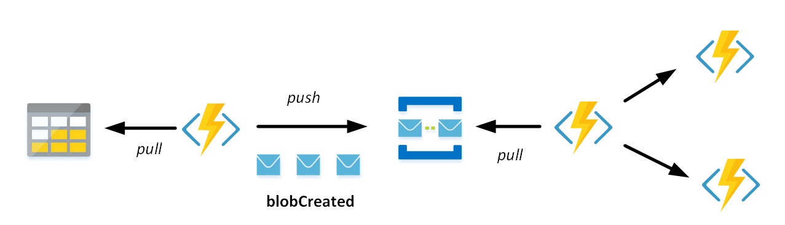
Event Grid – change this

Slide 57
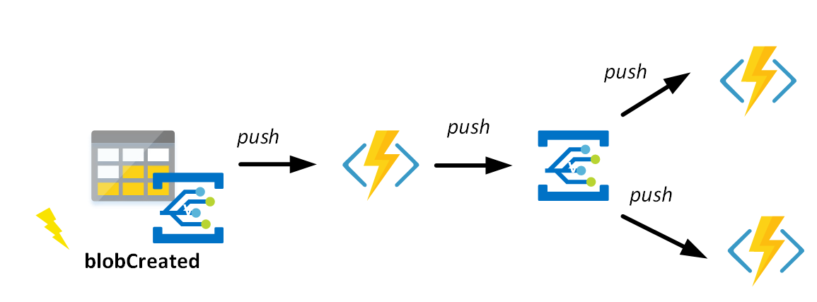
Event Grid – into this

Slide 58
Event Grid Publishers
Built in
Custom
Azure Subscriptions
Container Registry
Event Hubs
IoT Hub
Media Services
Resource Groups
Service Bus
Storage Blob
Storage General-purpose
Azure Maps
Whatever custom Topic you want and need

Slide 59
Event Grid Handlers
Built in
Custom
Azure Automation
Azure Functions
Event Hubs
Hybrid Connections
Logic Apps
Microsoft Flow
Queue Storage
WebHooks
As custom http endpoint
As custom Webhook endpoint

Slide 60
Event Grid „Limitation”
No Output binding in Functions
Not “easy“ to publish custom event
Azure UI… not always works

Slide 61
Event Grid - Demo
Creating Event Grid Topic
Adding Subscription
Publishing to Event Grid Topic
Reacting on custom Event Grid Topic

Slide 62
Event Grid – Exercises (easy)
Create function that reacts on Event Grid event
React on creating new blob
Return information about what blob had been created

Slide 63
Event Grid – Exercises (hard)
Create function (HttpTrigger)
Function should receive information about user (Name, email, Age, Fav animal: cat | dog)
Once proper information is received it should be published to custom topic
Make sure that event have been executed

Slide 64
Things to note
Pay as you go
Scalable solution with 99,99 SLA
Easy to start using it with our own code

Slide 65
Azure Logic App
Serverless Workflow

Slide 66
Logic App
A way to structure flow of serverless application
Allow integration between multiple parts
Business friendly – UI available
Dev friendly – All workflow as json file
Microsoft dev friendly – yep, Visual Studio UI available…

Slide 67
Logic App when to use it?
Simple repetitive tasks – summarize all expanses on monthly basis, sending email to newly hired employee
As integration between two system – adapter pattern
As an enricher
As a complex validation logic

Slide 68
Logic App - Demo
Create Logic App
Show Possible options
Show how to run simple flow

Slide 69
Logic App – Exercises
Create Logic App with HTTP entry point
Entry points should receive PESEL, full name and email
Validate PESEL with function
If succeed, send email to person and add full name to Google/Excel workbook
Generate new Event if

Slide 70
Things to note
Its not all about UI
But UI helps
Pay as you go
Serverless workflow manager

